Slide 1
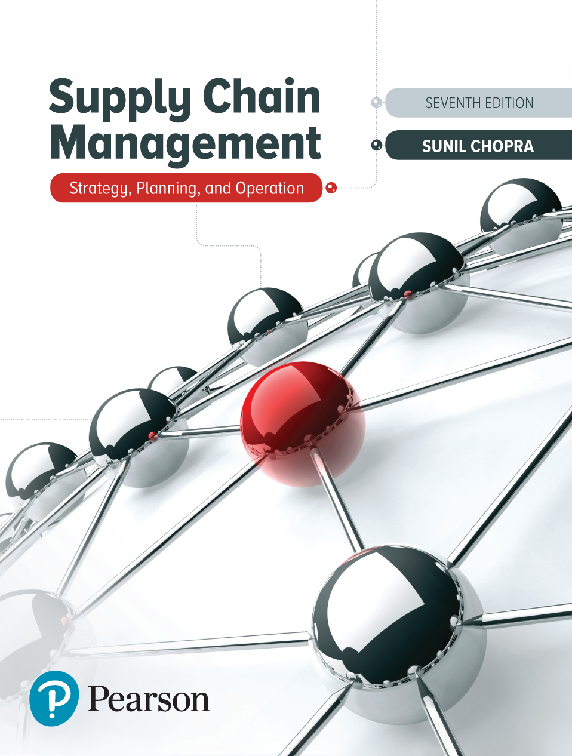
Supply Chain Management: Strategy, Planning, and Operation
Seventh Edition
Chapter 16
Pricing and Revenue Management in a Supply Chain
Copyright © 2019, 2016, 2013 Pearson Education, Inc. All Rights Reserved
Notes:
If this PowerPoint presentation contains mathematical equations, you may need to check that your computer has the following installed:
1) MathType Plugin
2) Math Player (free versions available)
3) NVDA Reader (free versions available)

Slide 2
Learning Objectives (1 of 2)
16.1 Understand the role of revenue management in a supply chain.
16.2 Identify how differential pricing can help increase profits when serving multiple customer segments.
16.3 Describe how dynamic pricing and overbooking can help increase profits from perishable assets.

Slide 3
Learning Objectives (2 of 2)
16.4 Discuss how peak pricing and off-peak discounts can help increase profits when demand is seasonal.
16.5 Describe how both buyers and sellers can combine long-term contracts and spot purchases to increase profits when demand is uncertain.
16.6 Understand the potential negative consequences of revenue management in practice.

Slide 4
The Role of Pricing and Revenue Management in the Supply Chain (1 of 2)
Revenue management is the use of pricing to increase the profit generated from a limited supply of supply chain assets
Supply assets exist in two forms – capacity and inventory
Revenue management may also be defined as the use of differential pricing based on customer segment, time of use, and product or capacity availability to increase supply chain profits

Slide 5
The Role of Pricing and Revenue Management in the Supply Chain (2 of 2)
Revenue management has a significant impact on supply chain profitability when one or more of the following four conditions exist
The value of the product varies in different market segments
The product is highly perishable or product wastage occurs
Demand has seasonal and other peaks
The product is sold both in bulk and on the spot market

Slide 6
Summary of Learning Objective 1 (1 of 2)
Revenue management uses differential pricing to better match supply and demand and increase supply chain profits. Traditionally, firms have changed the availability of assets to match supply and demand. Revenue management aims to reduce any supply/demand imbalance by using pricing as a lever. A big advantage of using revenue management is that a change in pricing is much easier to reverse compared with an investment in supply chain assets. When it is used properly, revenue management increases firm profits while leaving service sensitive customers more satisfied through greater asset availability and price sensitive customers more satisfied with lower prices.

Slide 7
Summary of Learning Objective 1 (2 of 2)
Revenue management is most effective in a supply chain when the value of the product varies by market segment, the product is highly perishable, product demand is seasonal, or the product is sold both in bulk and on the spot market.

Slide 8
Differential Pricing for Multiple Customer Segments (1 of 4)
Differential pricing increases total profits for a firm
Two fundamental issues must be handled in practice
How can the firm differentiate between the two segments and structure its pricing to make one segment pay more than the other?
How can the firm control demand such that the lower-paying segment does not utilize the entire availability of the asset?

Slide 9
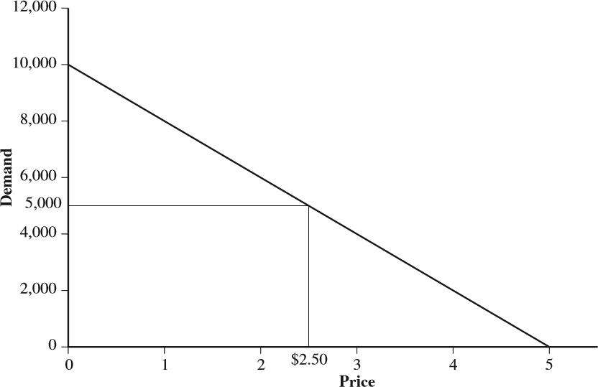
Differential Pricing for Multiple Customer Segments (2 of 4)
d = 10,000 – 2,000p
Figure 16-1 Revenue Generated by ToFrom Pricing for One Segment

Slide 10
Differential Pricing for Multiple Customer Segments (3 of 4)
d = 10,000 − 2,000p
Figure 16-2 Revenue Generated by ToFrom Pricing for Two Segments

Slide 11
Differential Pricing for Multiple Customer Segments (4 of 4)
Two problems to solve when using revenue management across multiple segments
What price should be charged for each segment?
How should limited capacity be allocated among the segments?

Slide 12
Pricing to Multiple Segments (1 of 5)
For capacity constrained by Q
Subject to

Slide 13
Pricing to Multiple Segments (2 of 5)

Slide 14
Pricing to Multiple Segments (3 of 5)
Same price to both segments

Slide 15
Pricing to Multiple Segments (4 of 5)
Total production capacity is limited to 4,000 units
Subject to

Slide 16
Pricing to Multiple Segments (5 of 5)
Figure 16-3 Solver Spreadsheet for Example 16-1

Slide 17
Allocating Capacity to Segments under Uncertainty (1 of 3)
Basic trade-off is between committing to an order from a lower-price buyer or waiting for a higher-price buyer to arrive
Spoilage
Spill

Slide 18
Allocating Capacity to Segments under Uncertainty (2 of 3)
Effective use of revenue management increases firm profits and improves service for the more valuable customer segment
Create different versions of a product targeted at different segments

Slide 19
Allocating Capacity to Segments under Uncertainty (3 of 3)
Tactics for multiple customer segments
Separate segments effectively on some service dimension (e.g. response time)
Charge different prices based on the value assigned by each segment
Forecast demand at the segment level
Save appropriate amount of the asset for the late arriving high price segments

Slide 20
Allocating Capacity to Uncertain Demand from Multiple Segments
Revenue from segment A,
Revenue from segment B,
Mean demand for segment A,
Standard deviation of demand for A,

Slide 21
Summary of Learning Objective 2
If a supplier serves multiple customer segments with a fixed asset, it can improve revenues by setting different prices for each segment. Compared to charging a single fixed price to all customers, differential pricing charges the less price sensitive segment a higher price and the more price sensitive segment a lower price. Segments are typically separated along a dimension such as lead time so that the segment willing to pay more must pay a higher price to take advantage of shorter lead times. Given that demand is uncertain, the amount of the asset reserved for the higher-price segment is such that the expected marginal revenue from the higher-price segment equals the price to the lower-price segment.

Slide 22
Dynamic Pricing and Overbooking for Perishable Assets
Any asset that loses value over time is perishable
Two basic approaches
Vary price dynamically over time to maximize expected revenue, dynamic pricing
Overbook sales of the asset to account for cancellations

Slide 23
Dynamic Pricing (1 of 4)
Effective differential pricing generally increases the level of product availability for the consumer willing to pay full price and total profits for the retailer
Subject to

Slide 24
Dynamic Pricing (2 of 4)
Effective differential pricing generally increases the level of product availability for the consumer willing to pay full price and total profits for the retailer
Subject to

Slide 25
Dynamic Pricing (3 of 4)
Figure 16-4 Solver Spreadsheet for Example 16-3 for Dynamic Pricing

Slide 26
Dynamic Pricing (4 of 4)
Figure 16-5 Solver Spreadsheet for Example 16-3 for Fixed Price over Season

Slide 27
Evaluating Initial Quantity with Dynamic Pricing (1 of 2)
Subject to

Slide 28
Evaluating Initial Quantity with Dynamic Pricing (2 of 2)
Figure 16-6 Solver Spreadsheet for Example 16-4 for Optimal Quantity and Dynamic Prices

Slide 29
Overbooking in the Presence of Cancellation
Basic trade-off is between having wasted capacity because of excessive cancellations or having a shortage of capacity because of few cancellations requiring expensive backup

Slide 30
Overbooking
Cost of wasted capacity,
Cost of capacity shortage,

Slide 31
Summary of Learning Objective 3 (1 of 2)
Dynamic pricing can be a powerful tool to increase profits if the customers’ sensitivity to price changes in the course of the season for a perishable asset. This is often the case for fashion products, for which less price sensitive customers are willing to pay higher prices early in the season but more price sensitive arrive towards the end of the season looking for a bargain. Dynamic pricing should, however, carefully consider strategic behavior by customers who may anticipate future price drops and delay their purchase.

Slide 32
Summary of Learning Objective 3 (2 of 2)
With strategic customers it may be better to have a fixed price or reduce the quantity offered. For perishable assets, overbooking or overselling of a supply chain asset is a valuable tactic if order cancellations occur. The level of overbooking is based on the trade-off between the cost of wasting the asset if too many cancellations lead to unused assets and the cost of arranging a backup if too few cancellations lead to committed orders being larger than the available capacity.

Slide 33
Discounting and Peak Pricing for Seasonal Demand
Seasonal peaks of demand common in many supply chains
Off-peak discounting can shift demand from peak to non-peak periods
Charge higher price during peak periods and a lower price during off-peak periods
Increases profits for the owner of assets, decreases the price paid by a fraction of customers, and brings in new customers during the off-peak discount period

Slide 34
Summary of Learning Objective 4
A combination of off-peak discounting and peak pricing can be an effective revenue management tactic for owners of production or transportation capacity in any supply chain facing seasonal peak demand. This tactic increases profits for the owner of assets, provides better service to customers served during the peak, decreases the price paid by a fraction of customers, and also brings in potentially new customers during the off-peak discount period.

Slide 35
Constructing a Portfolio of Bulk Contracts and Spot Buying (1 of 2)
Problems constructing a portfolio of long-term bulk contracts and short-term spot market contracts
Decide what fraction of the asset to sell in bulk and what fraction of the asset to save for the spot market
The amount reserved for the spot market should be such that the expected marginal revenue from the spot market equals the current revenue from a bulk sale

Slide 36
Constructing a Portfolio of Bulk Contracts and Spot Buying (2 of 2)

Slide 37
Long-Term Bulk Contracts Versus the Spot Market
Bulk contract cost,
Spot market cost,

Slide 38
Summary of Learning Objective 5
For a seller using both long-term bulk contracts and the spot market, the basic revenue management decision is the fraction of the asset to save for the spot market. The basic trade-off is between getting a committed demand at a lower price with the bulk contract and potentially getting a high price on the spot market. For a buyer, the basic decision is the fraction of anticipated demand to purchase from a long-term bulk contract. The basic trade-off is between getting a long-term bulk contract at a low price that may not be fully used and purchasing only the amount required from the spot market but at a higher price.

Slide 39
Some Practical Challenges When Using Revenue Management
Potential pitfalls if not used carefully
Consumer preference must be accounted for
Salesforce and operations must be fully informed and trained to deal with the consequences of revenue management
Inform the customer when implementing revenue management
Keep revenue management techniques simple

Slide 40
Summary of Learning Objective 6
The failure to anticipate consumer behavior when using revenue management and develop an appropriate response can have significant negative consequences. It is important for firms to ensure that revenue management techniques do not diminish customer loyalty and encourage them to game the system. This is only possible if revenue management improves service for the segment of valuable customers along some dimension they consider important. These dimensions should be clearly communicated to the salesforce and operations must be prepared to respond appropriately when customers face negative outcomes resulting from revenue management.

Slide 41

Copyright

